Slide 1
Real Time Energy Price Forecast
forecasting energy Real Time prices by market and region one day ahead and comparing to Day Ahead pricing to make a purchasing decision at a certain point in time

Slide 2
Goal Statement
Provide a buy now or buy later recommendations based on our forecasted RT-LMP
Based on weather & load demand variables that seem to have historically impacted energy prices, forecast RT-LMP (Real Time – Locational Marginal Price)
Identify correlations between RT-LMP and forecasted weather variables such as, temperature, humidity, precipitation; as well as energy load

Slide 3
Energy Trading and Marketing
energy trading and marketing” is the buying, selling and moving of bulk energy (electricity ) from where it is produced to where it is needed.
Wholesale electricity is traded as commodity, much like corn or gold and other minerals.
Commodity markets are frequently volatile, meaning that the price of energy bought and sold in the wholesale marketplace can change often, and at times dramatically.
Wholesale energy prices are set by the basic market forces of supply and demand. In North America, the price of energy is typically higher during the cold winter months, with an increased need for heating, and again during the warmer summer months when the use of air conditioning increases in warmer climates.
Daily price fluctuations also exist. Demand and prices generally increase during working hours (“peak” hours) and drop overnight when activity is low (“off-peak” hours).

Slide 4
Energy Markets
The Energy Market procures electricity to meet consumers’ demands both in real-time and in the near-term. It includes the sale or purchase of energy in the Real-Time (five minutes forward) Energy Market and Day-Ahead Market (one day forward).

Slide 5
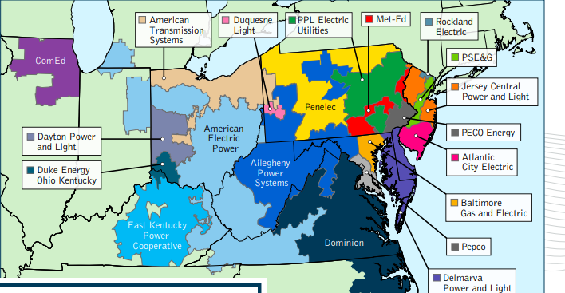
PJM Electric Market
PJM Interconnection is a regional transmission organization (RTO) that coordinates the movement of wholesale electricity in all or parts of Delaware, Illinois, Indiana, Kentucky, Maryland, Michigan, New Jersey, North Carolina, Ohio, Pennsylvania, Tennessee, Virginia, West Virginia and the District of Columbia.

Slide 6
Real Time vs Day Ahead Market
PJM’s Real-Time Market is a spot market – meaning that the product is procured for immediate delivery - in which current prices (called locational marginal prices) are calculated at five-minute intervals based on actual grid operating conditions. Real-time energy prices are posted on the PJM Operational Data webpage.
PJM’s Day-Ahead Market is a forward market in which hourly locational marginal prices are calculated for the next day based on the amount of energy generators offered to produce, the amount of energy needed by consumers and scheduled transactions between buyers and sellers of energy.

Slide 8
Data Sources & tools
PJM historical hourly pricing data
Weather data (World Weather API @ https://www.apixu.com/api.aspx)
Historical
1 day ahead forecasted
Minitab – to perform stepwise regression for the weather variables referenced
Excel
Jupyter Notebook

Slide 9
Approach
Obtain and combine historical pricing, load forecast and weather data
Step wise regression in Minitab
Store regression weights in a data frame
Get request for tomorrow’s forecasted weather
Forecast tomorrow’s hourly real time pricing and compare to day ahead market pricing
Make a buy recommendation each hour

Slide 10
Factors that Affect Real Time Pricing
Energy load demand
Temperature
Precipitation
Humidity
Time during the day

Slide 11
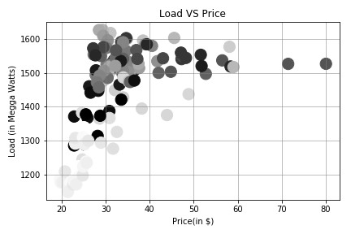
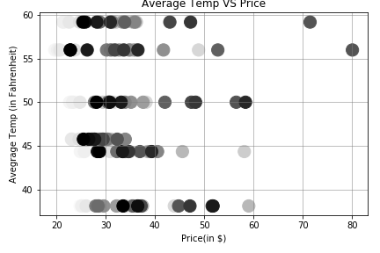
Factor Correlation

Slide 12
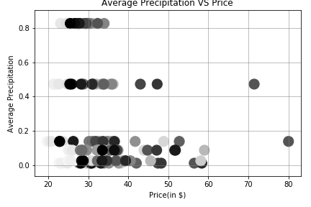
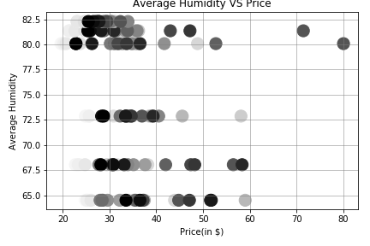
Factor Correlation (contd…)

Slide 13

Stepwise Regression
Continuous Variables Selected
Temperature
Humidity
Precipitation
Wind Speed
Categorical Variables Selected
Hour of the Day

Slide 14
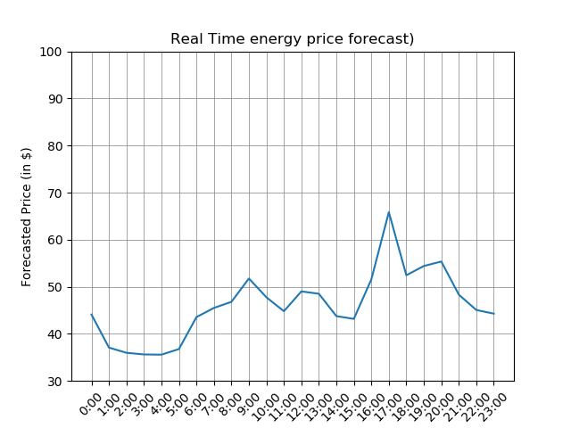
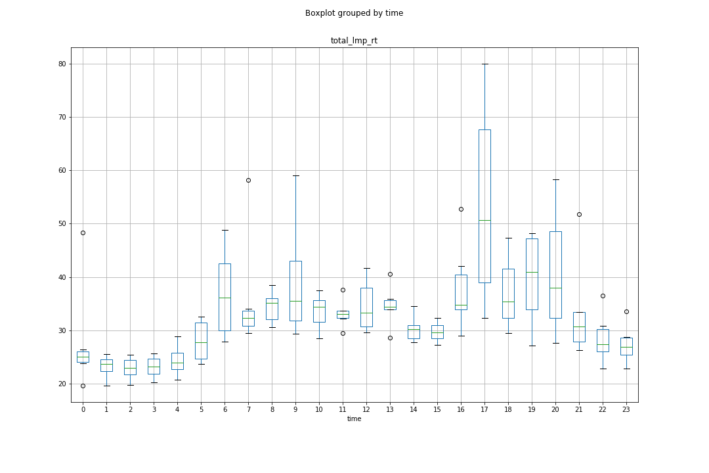
Forecasted Hourly Real Time Price 11/14/18

Slide 15
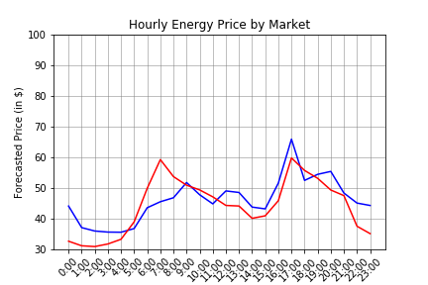
Forecasted Real Time Market Price vs Next Day Market Price

Slide 16
Market Recommendation
If the Forecasted Real Time Market price is higher than the Next Day Market Price, then we recommend to purchase the Next Day Market Price for that hour
Time | 0:00 | 1:00 | 2:00 | 3:00 | 4:00 | 5:00 | 6:00 | 7:00 | 8:00 | 9:00 | 10:00 | 11:00
Market Rec. | DA | DA | DA | DA | DA | RT | RT | RT | RT | DA | RT | RT
Time | 12:00 | 13:00 | 14:00 | 15:00 | 16:00 | 17:00 | 18:00 | 19:00 | 20:00 | 21:00 | 22:00 | 23:00
Market Rec. | DA | DA | DA | DA | DA | DA | RT | DA | DA | DA | DA | DA

Slide 17
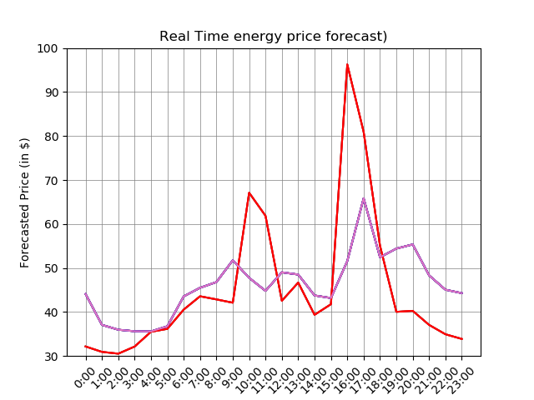
Forecasted vs Actual Real Time Prices 11/14/18

Slide 18
Buy Analysis for 11/14/18
Assuming # of units is equal for each hour
Sum of Hourly Real Time Market Prices = $1,084.35
Sum of Hourly Next Day Market Prices = $1,062.08
Sum of Hourly Price Recommendation Prices = $1,025.91
Selected the correct price in 12 of the 24 hours, net $-35.50 per unit

Slide 19
Challenges & Areas of Improvement
Hourly weather forecast
More historical data to improve regression model
Software limitations of # independent variables
PJM API integration to fully automate the forecast and recommendation model
Apply to other Energy Companies

